Slide 1
Introduction to TurboPi

Slide 2
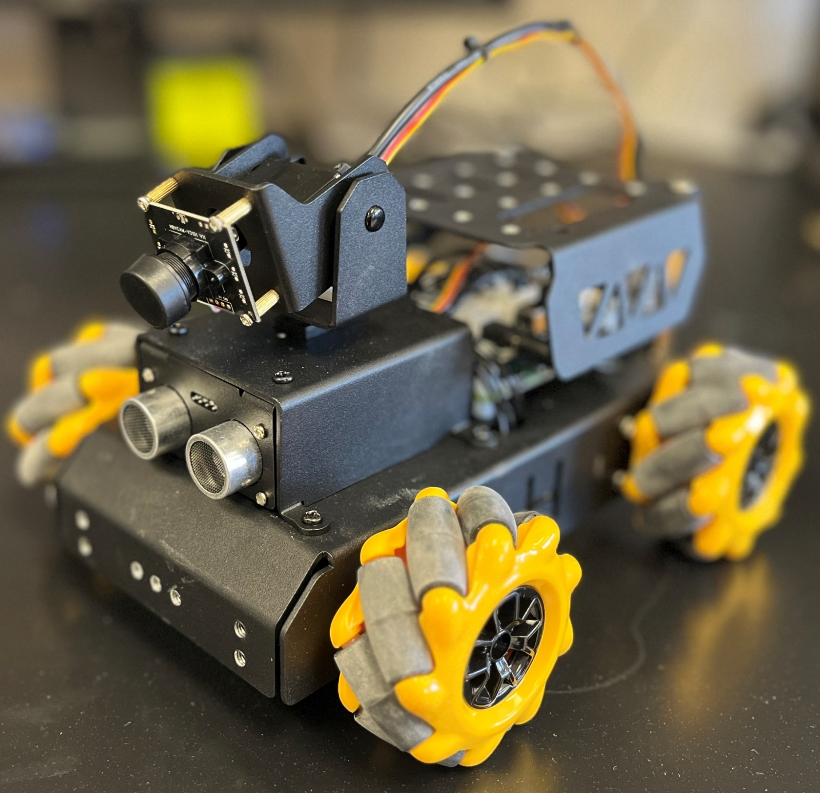
TurboPi - Overview
TurboPi is:
Built and maintained by Shenzhen HiWonder Technology Company, usually abbreviated to HiWonder
A mobile platform built around the raspberry pi
Designed to be used for introducing robotics and ML to high school students
Is plug and play with more sensors and a robotic arm
HiWonder maintains online documentation (Link) but you can also find it on your flash drive along with the image for this workshop

Slide 3
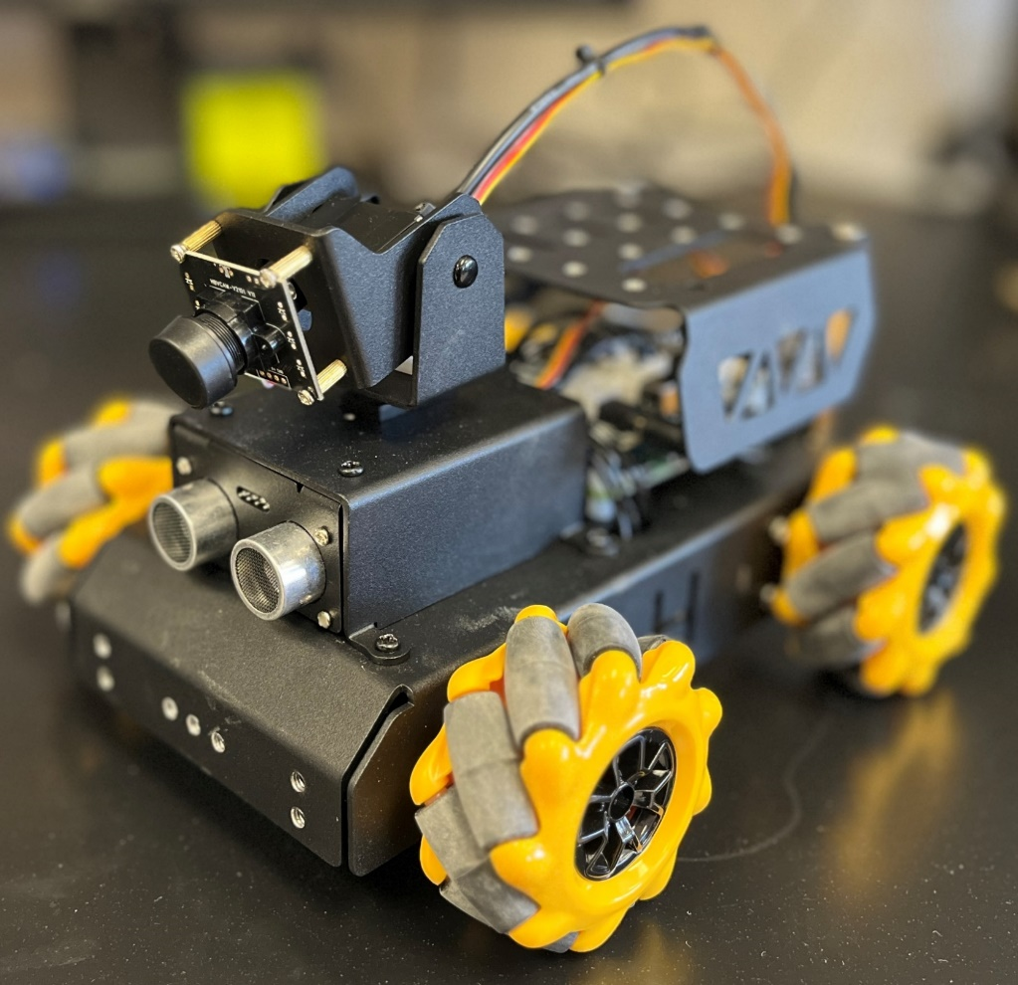
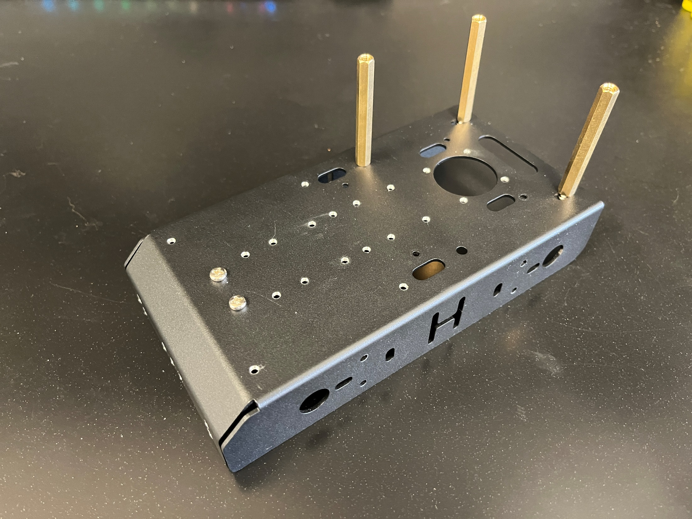
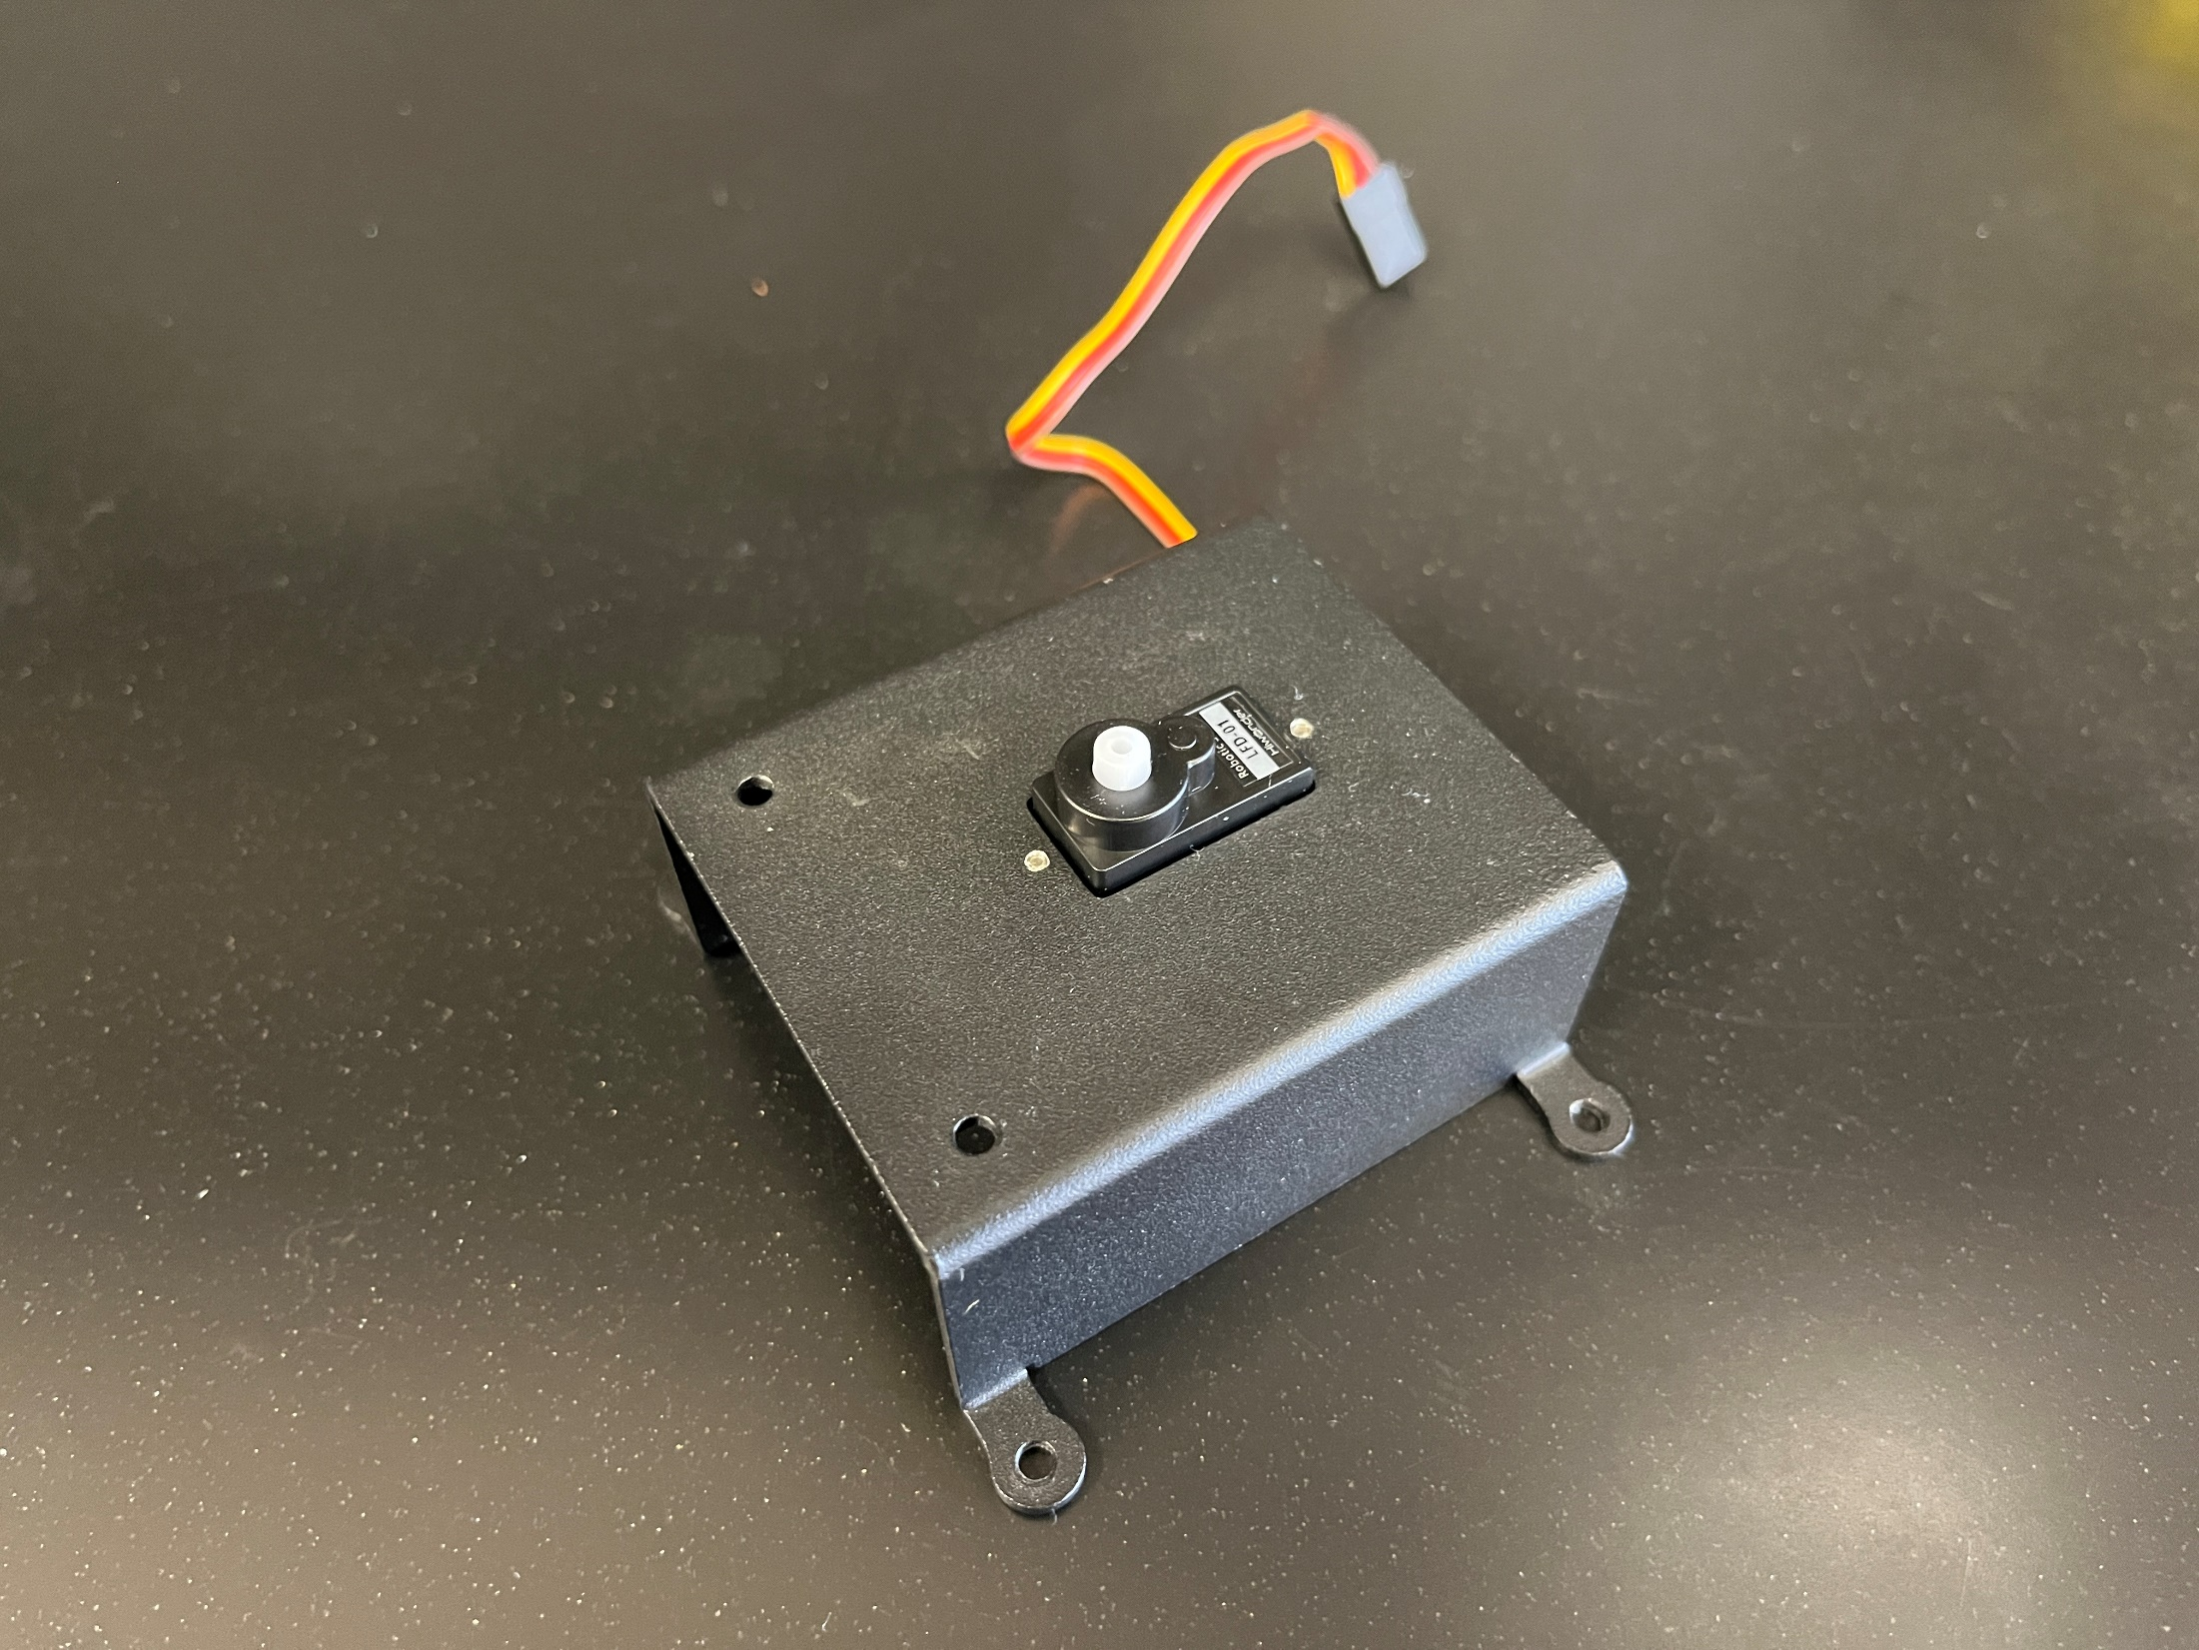
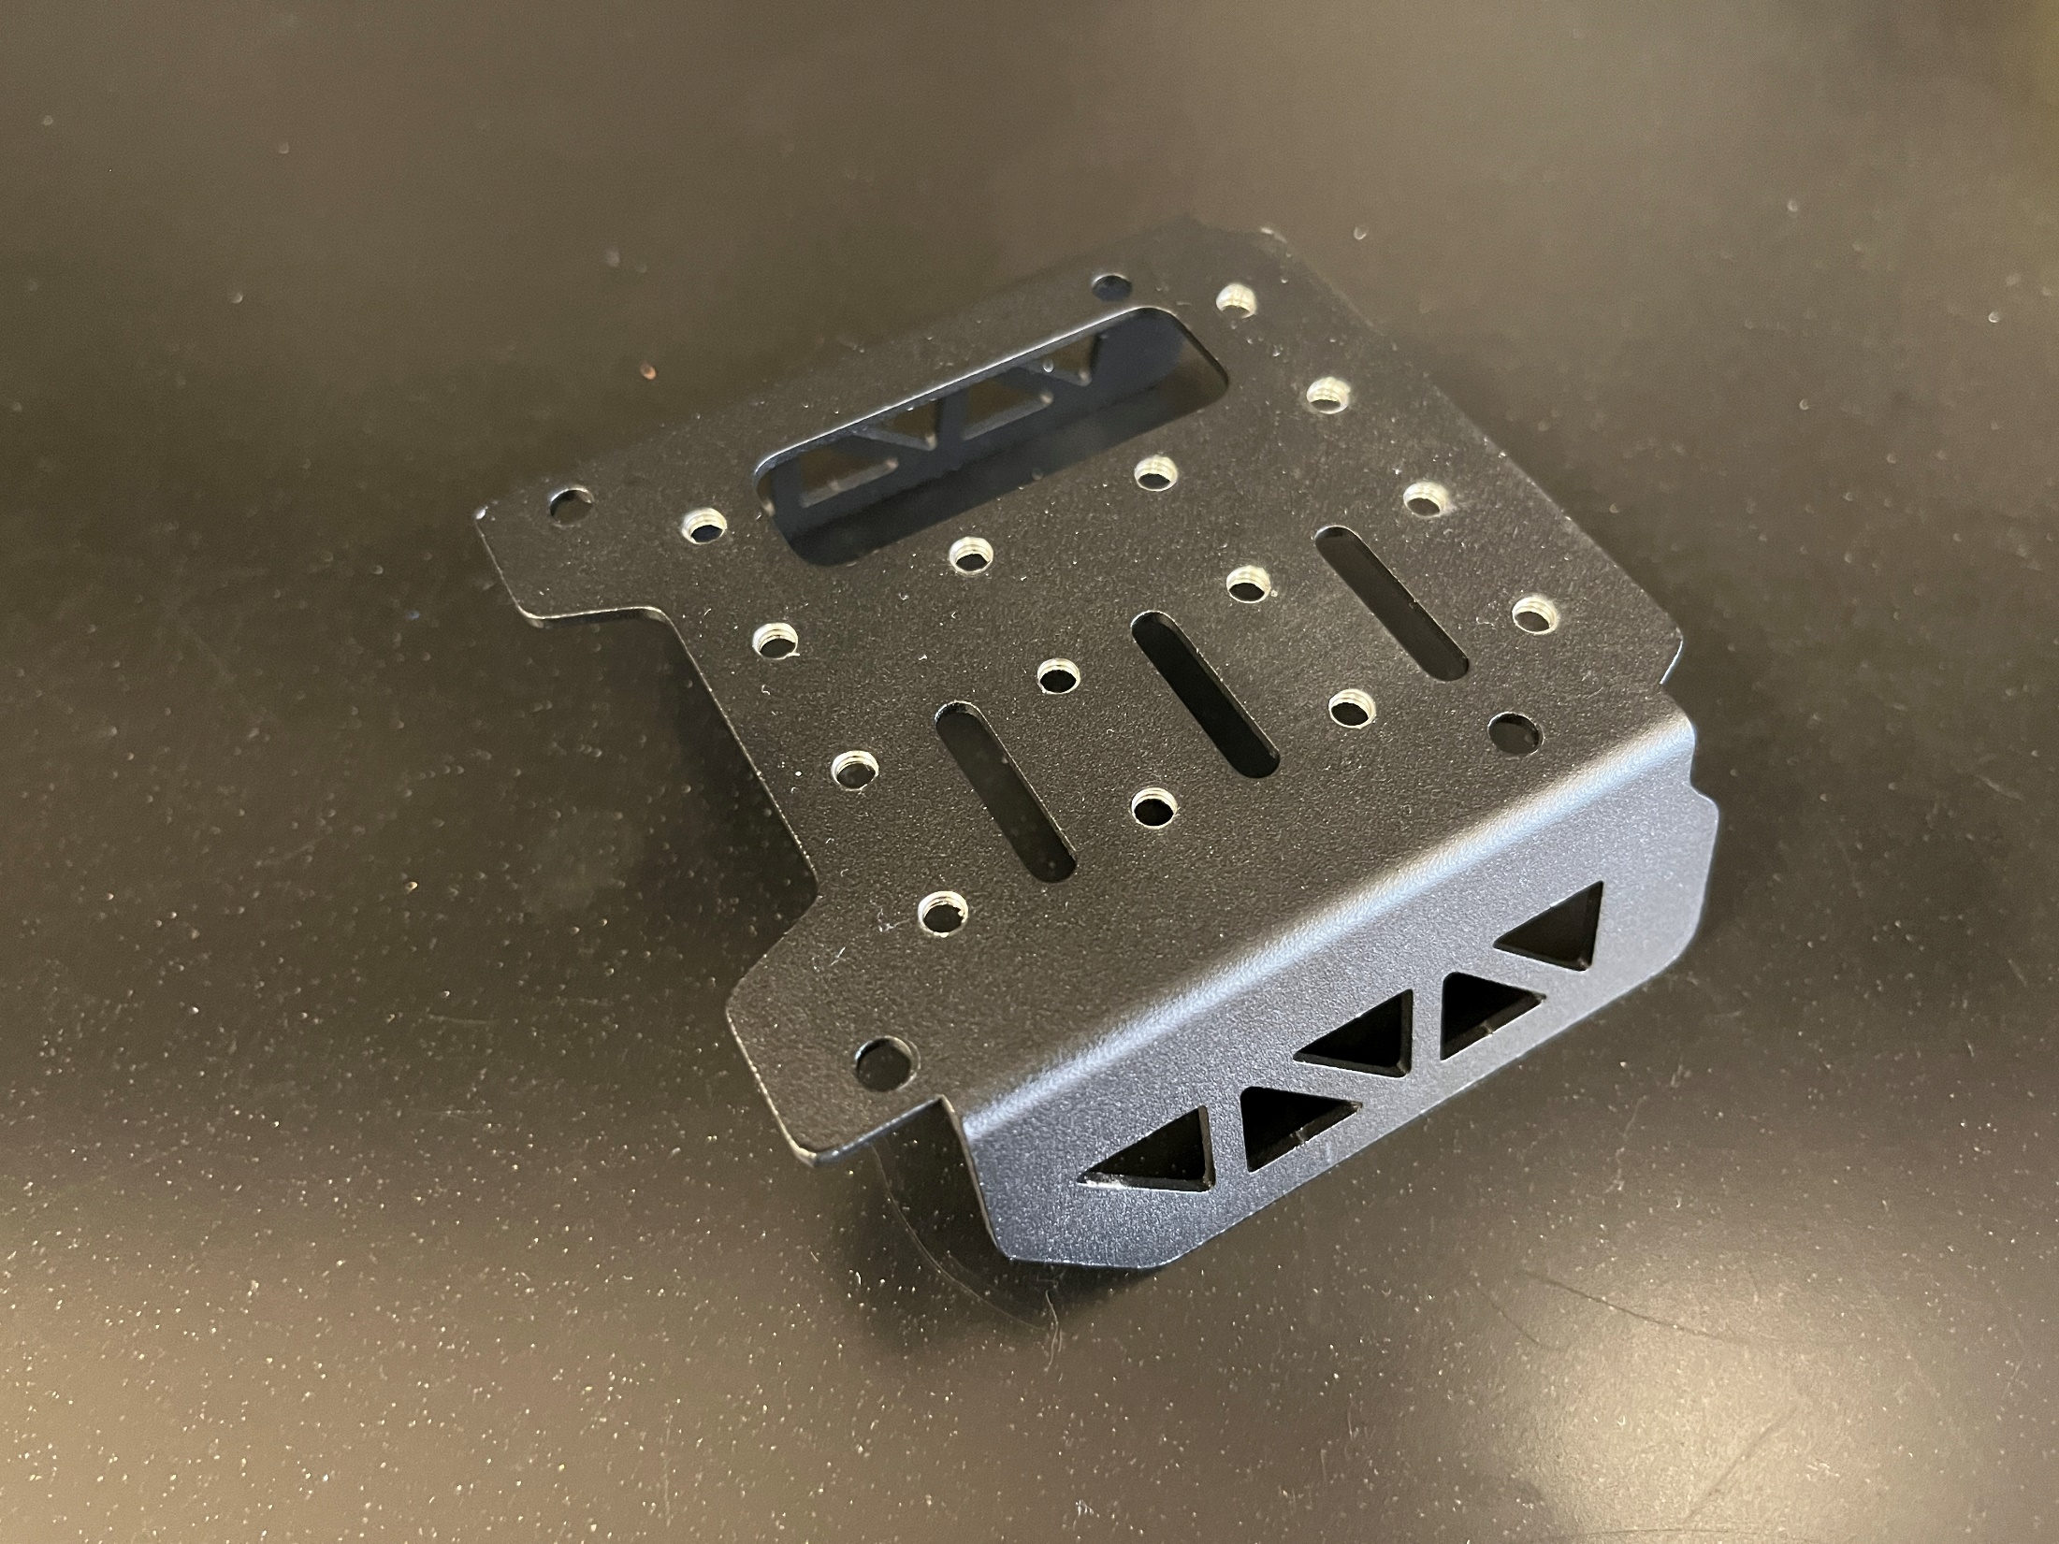
Chassis
Painted aluminum alloy
Divided into 3 sections
The main chassis
The camera mount box
The expansion platform above the pi

Slide 4
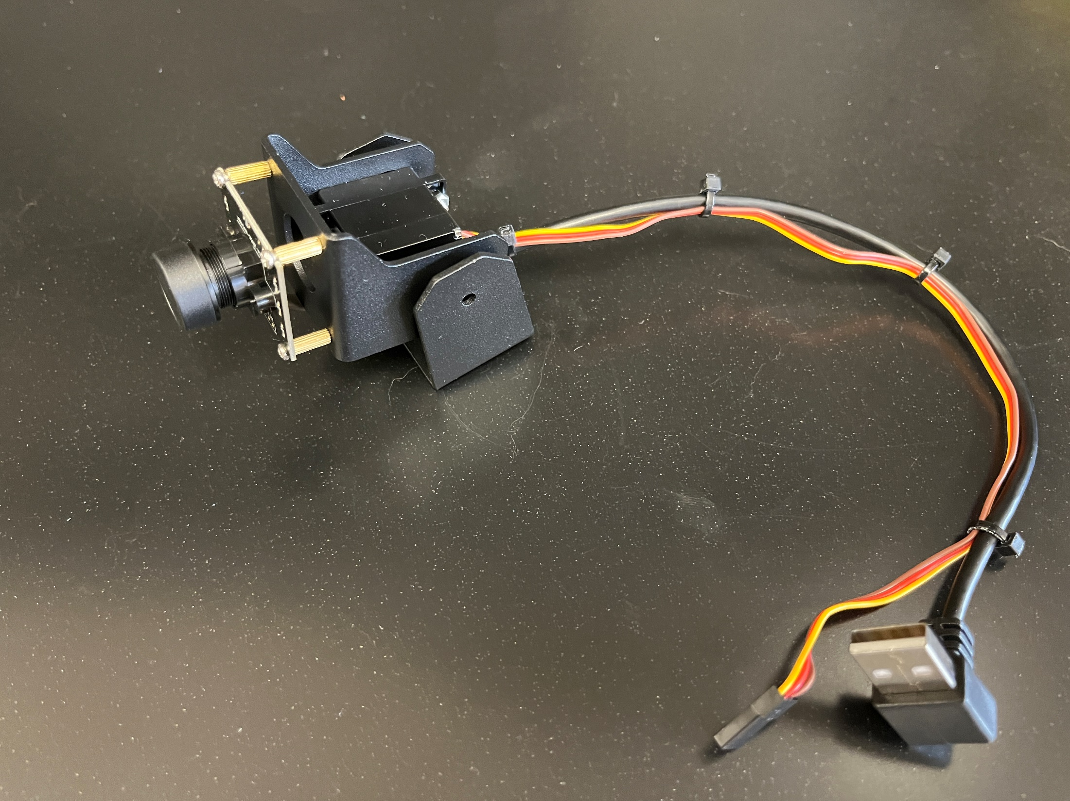
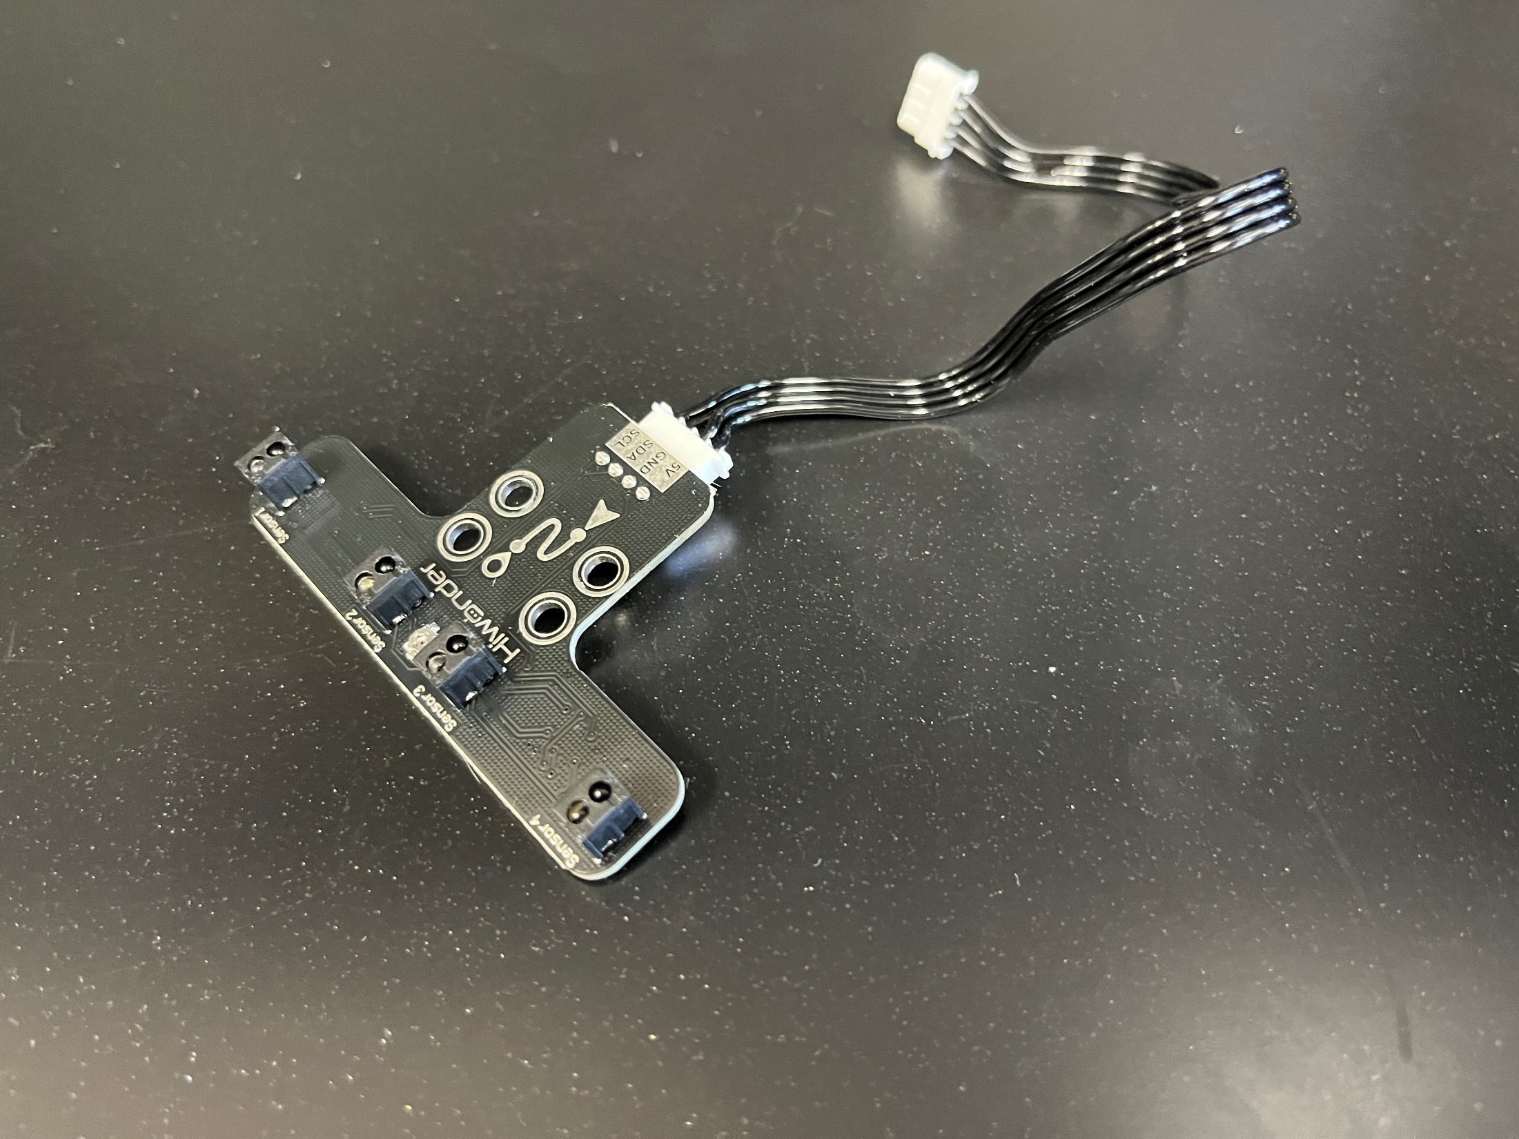
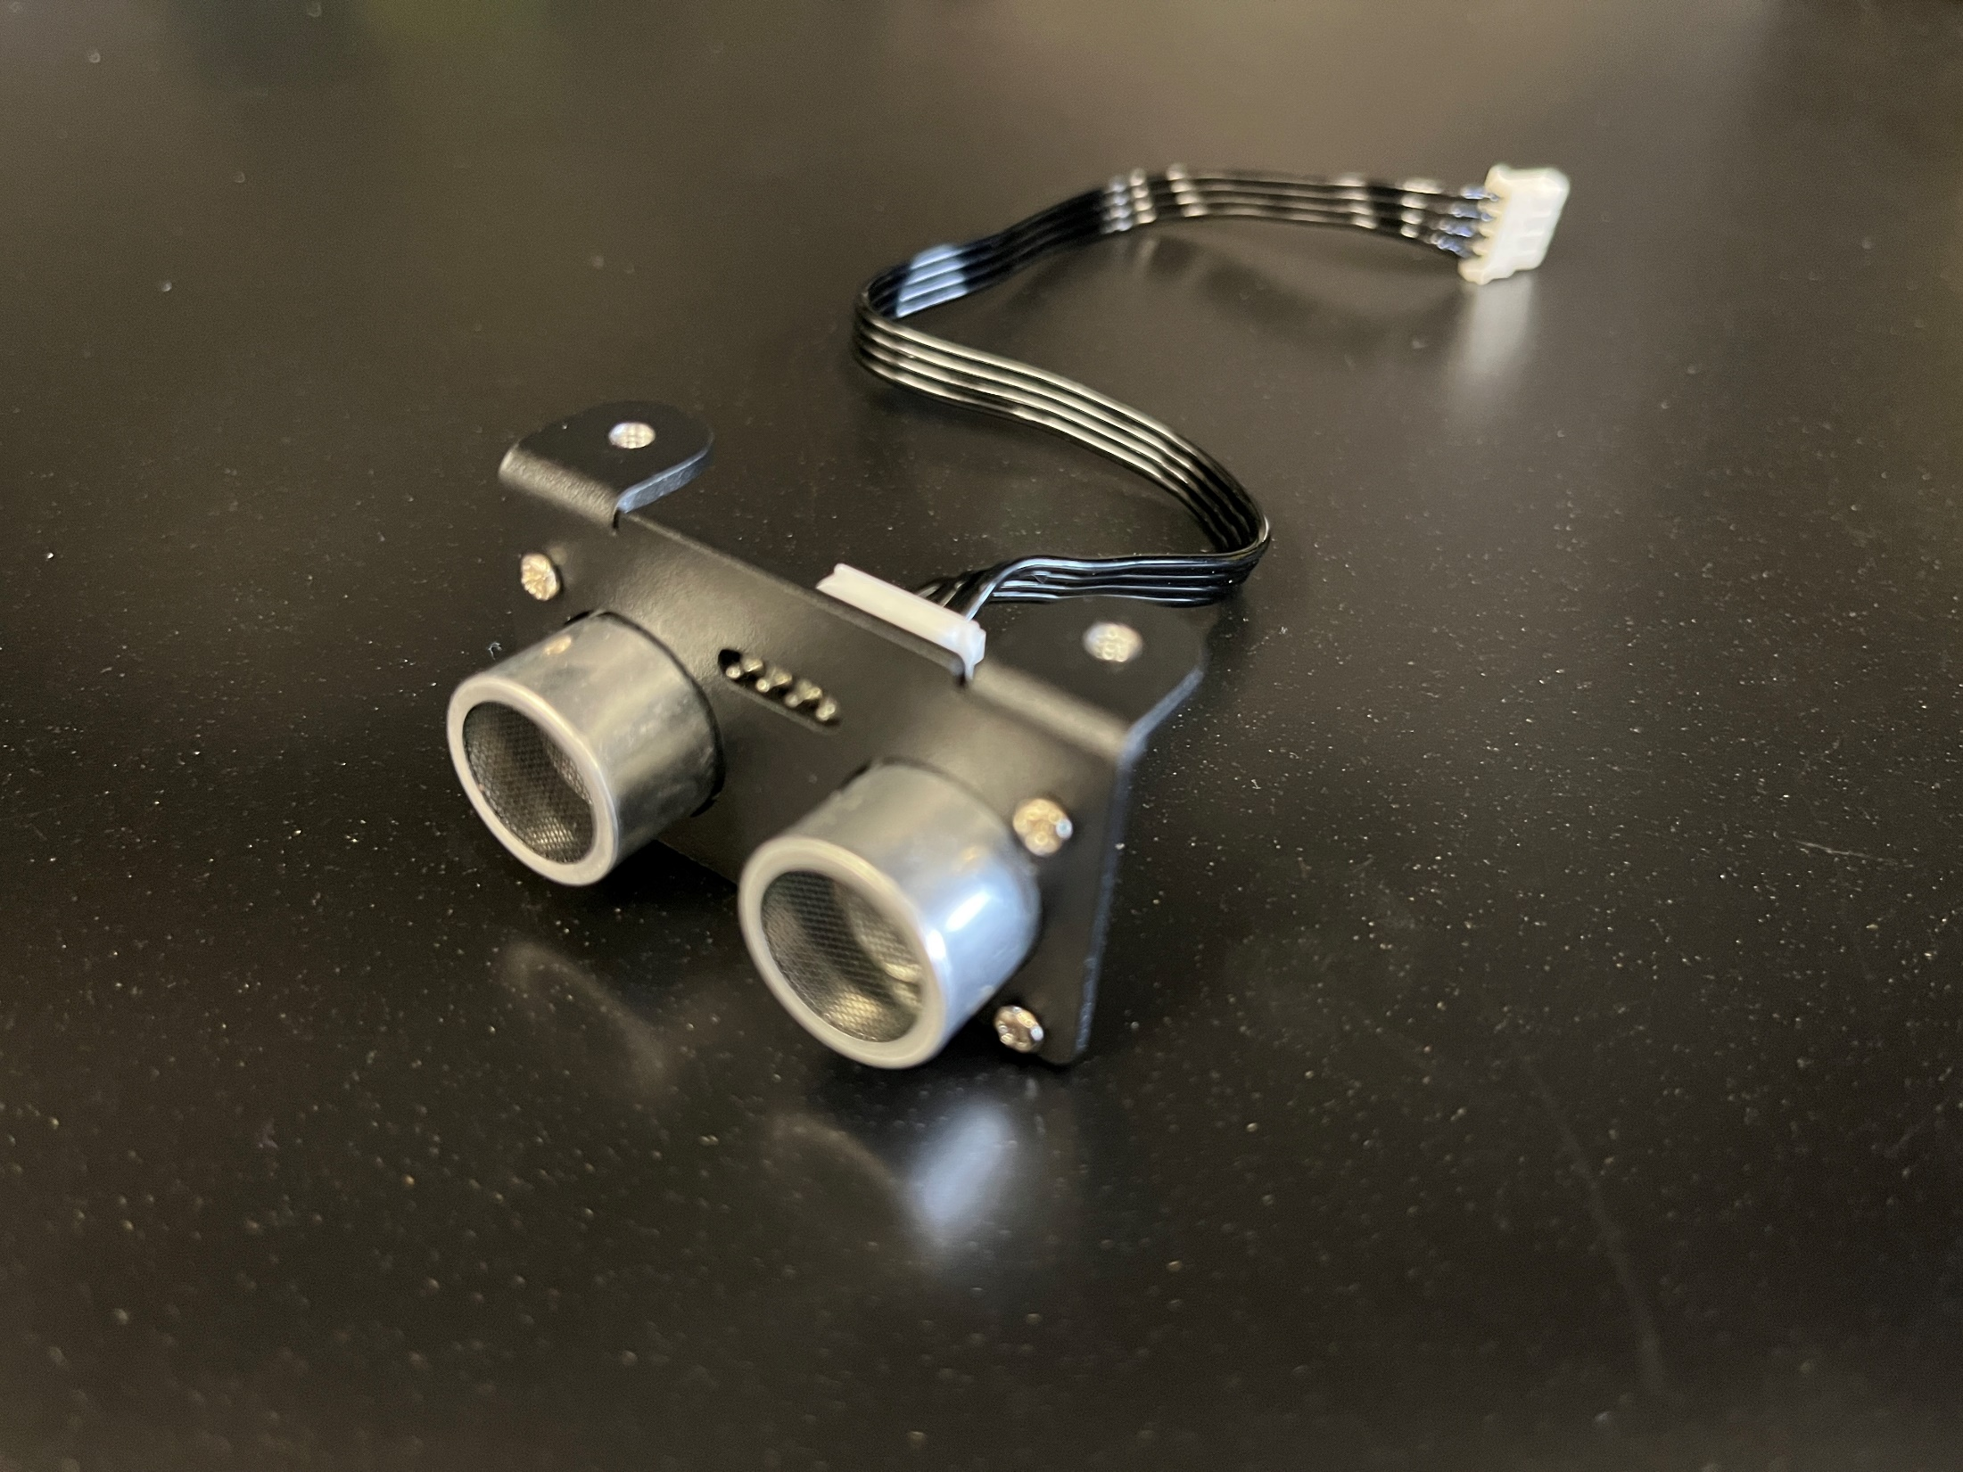
Sensors
120 degree FOV HBVCAM camera​
2 LFD-01 anti-blocking servos for camera positioning​
4 channel front mounted IR sensor board​
Ultrasonic sensor with adjustable LEDs​

Slide 5
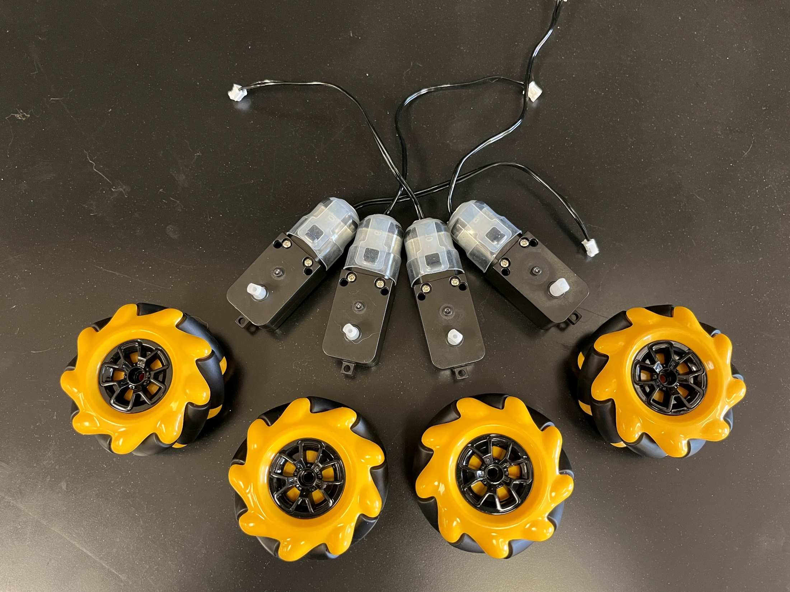
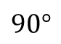
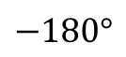

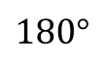
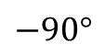
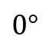
Motors
4 TT DC motors with Mecanum omnidirectional wheels
Wheels are controlled using the polar coordinate system​
We will discuss this more when we program the TurboPi to drive
$$0°$$
r
$$90°$$
$$θ$$
$$−90°$$
$$180°$$
$$−180°$$

Slide 6
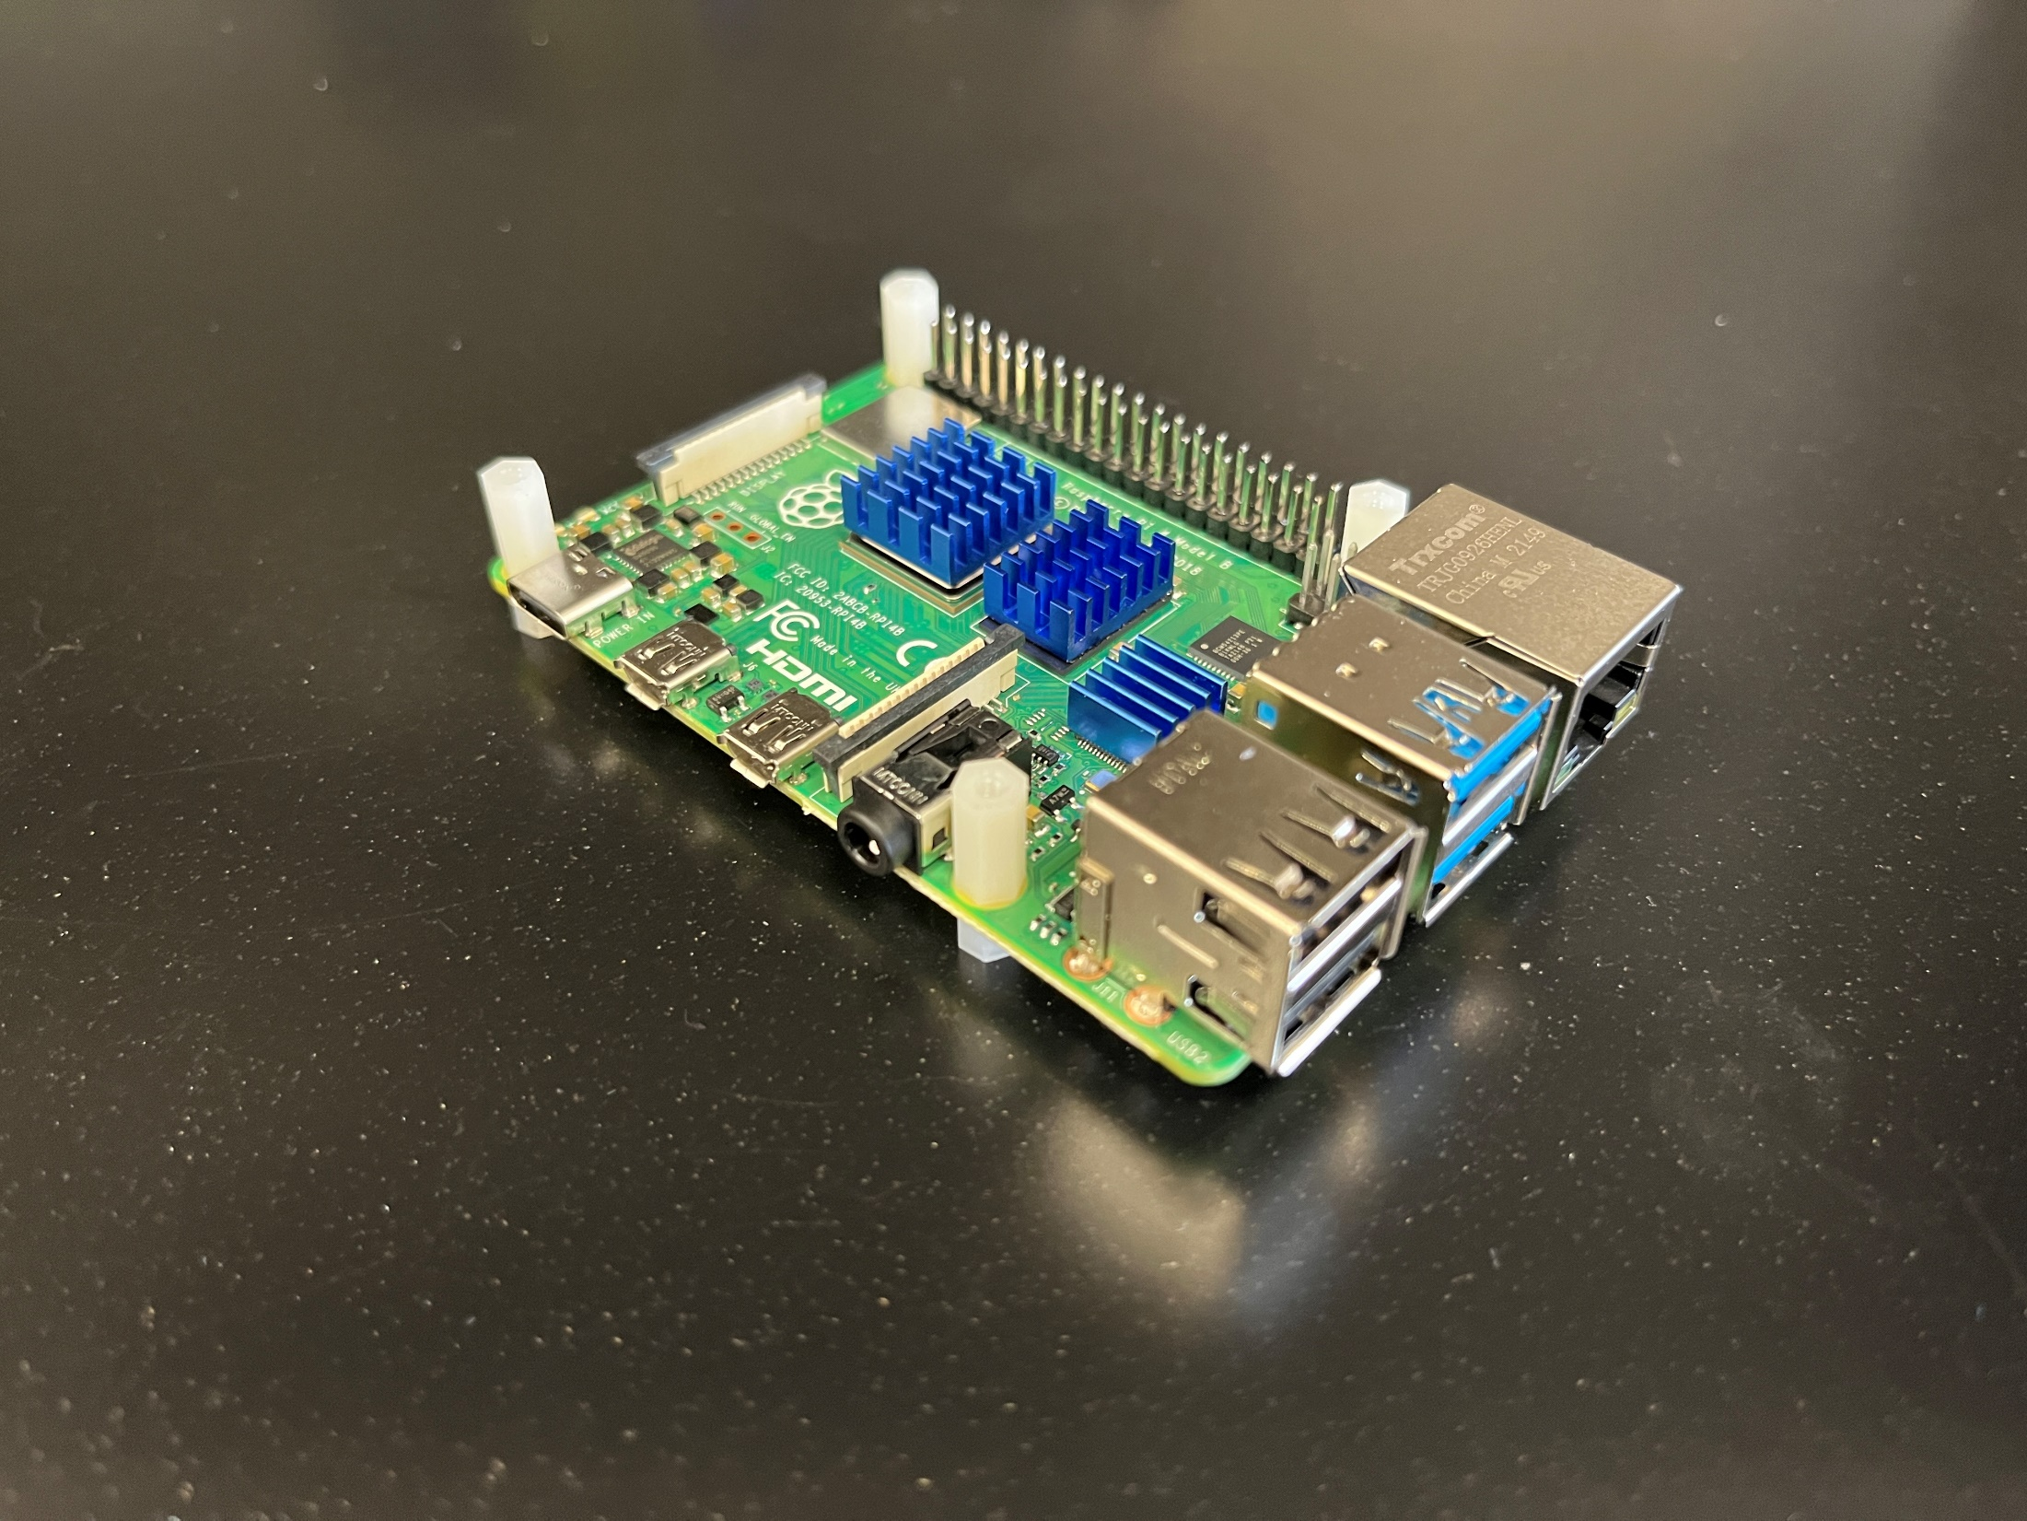
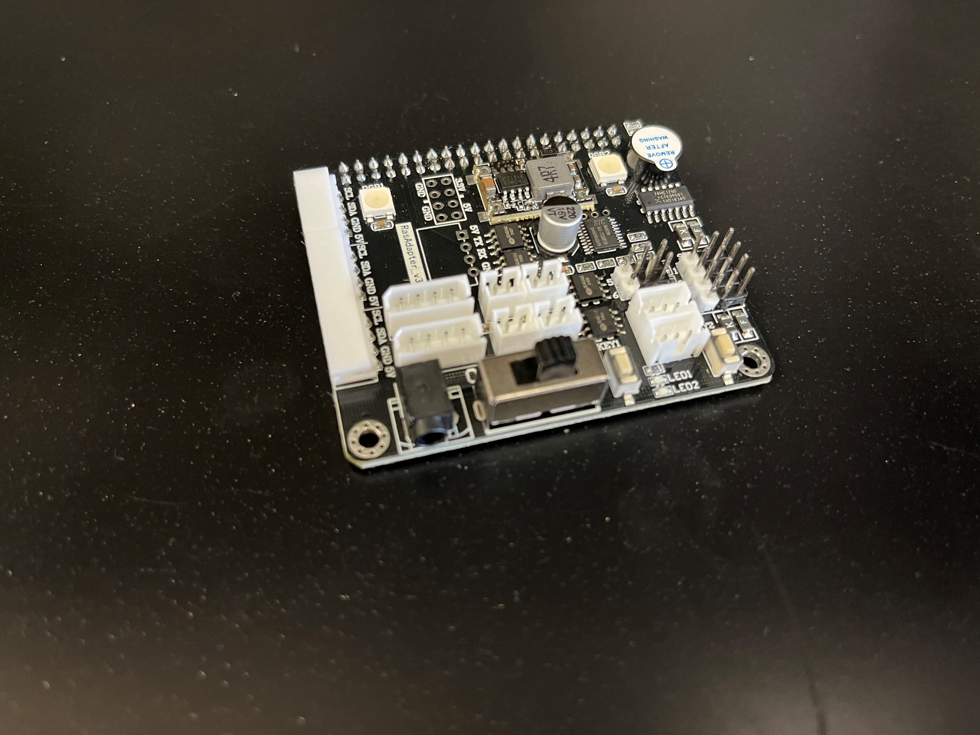
Controller
The onboard computer is a Raspberry Pi
The sensors connect to the Pi through the HiWonder TurboPi HAT
On the Hat:
LED1 should be on and strong when the TurboPi is operating normally​
LED2 should flash when the wireless hotspot is operating normally
When LED1 and LED2 are dim the batteries are too low to properly power the TurboPi

Slide 7
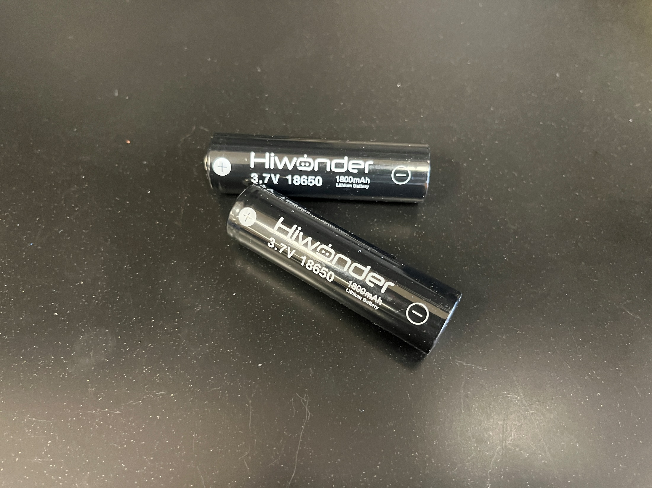
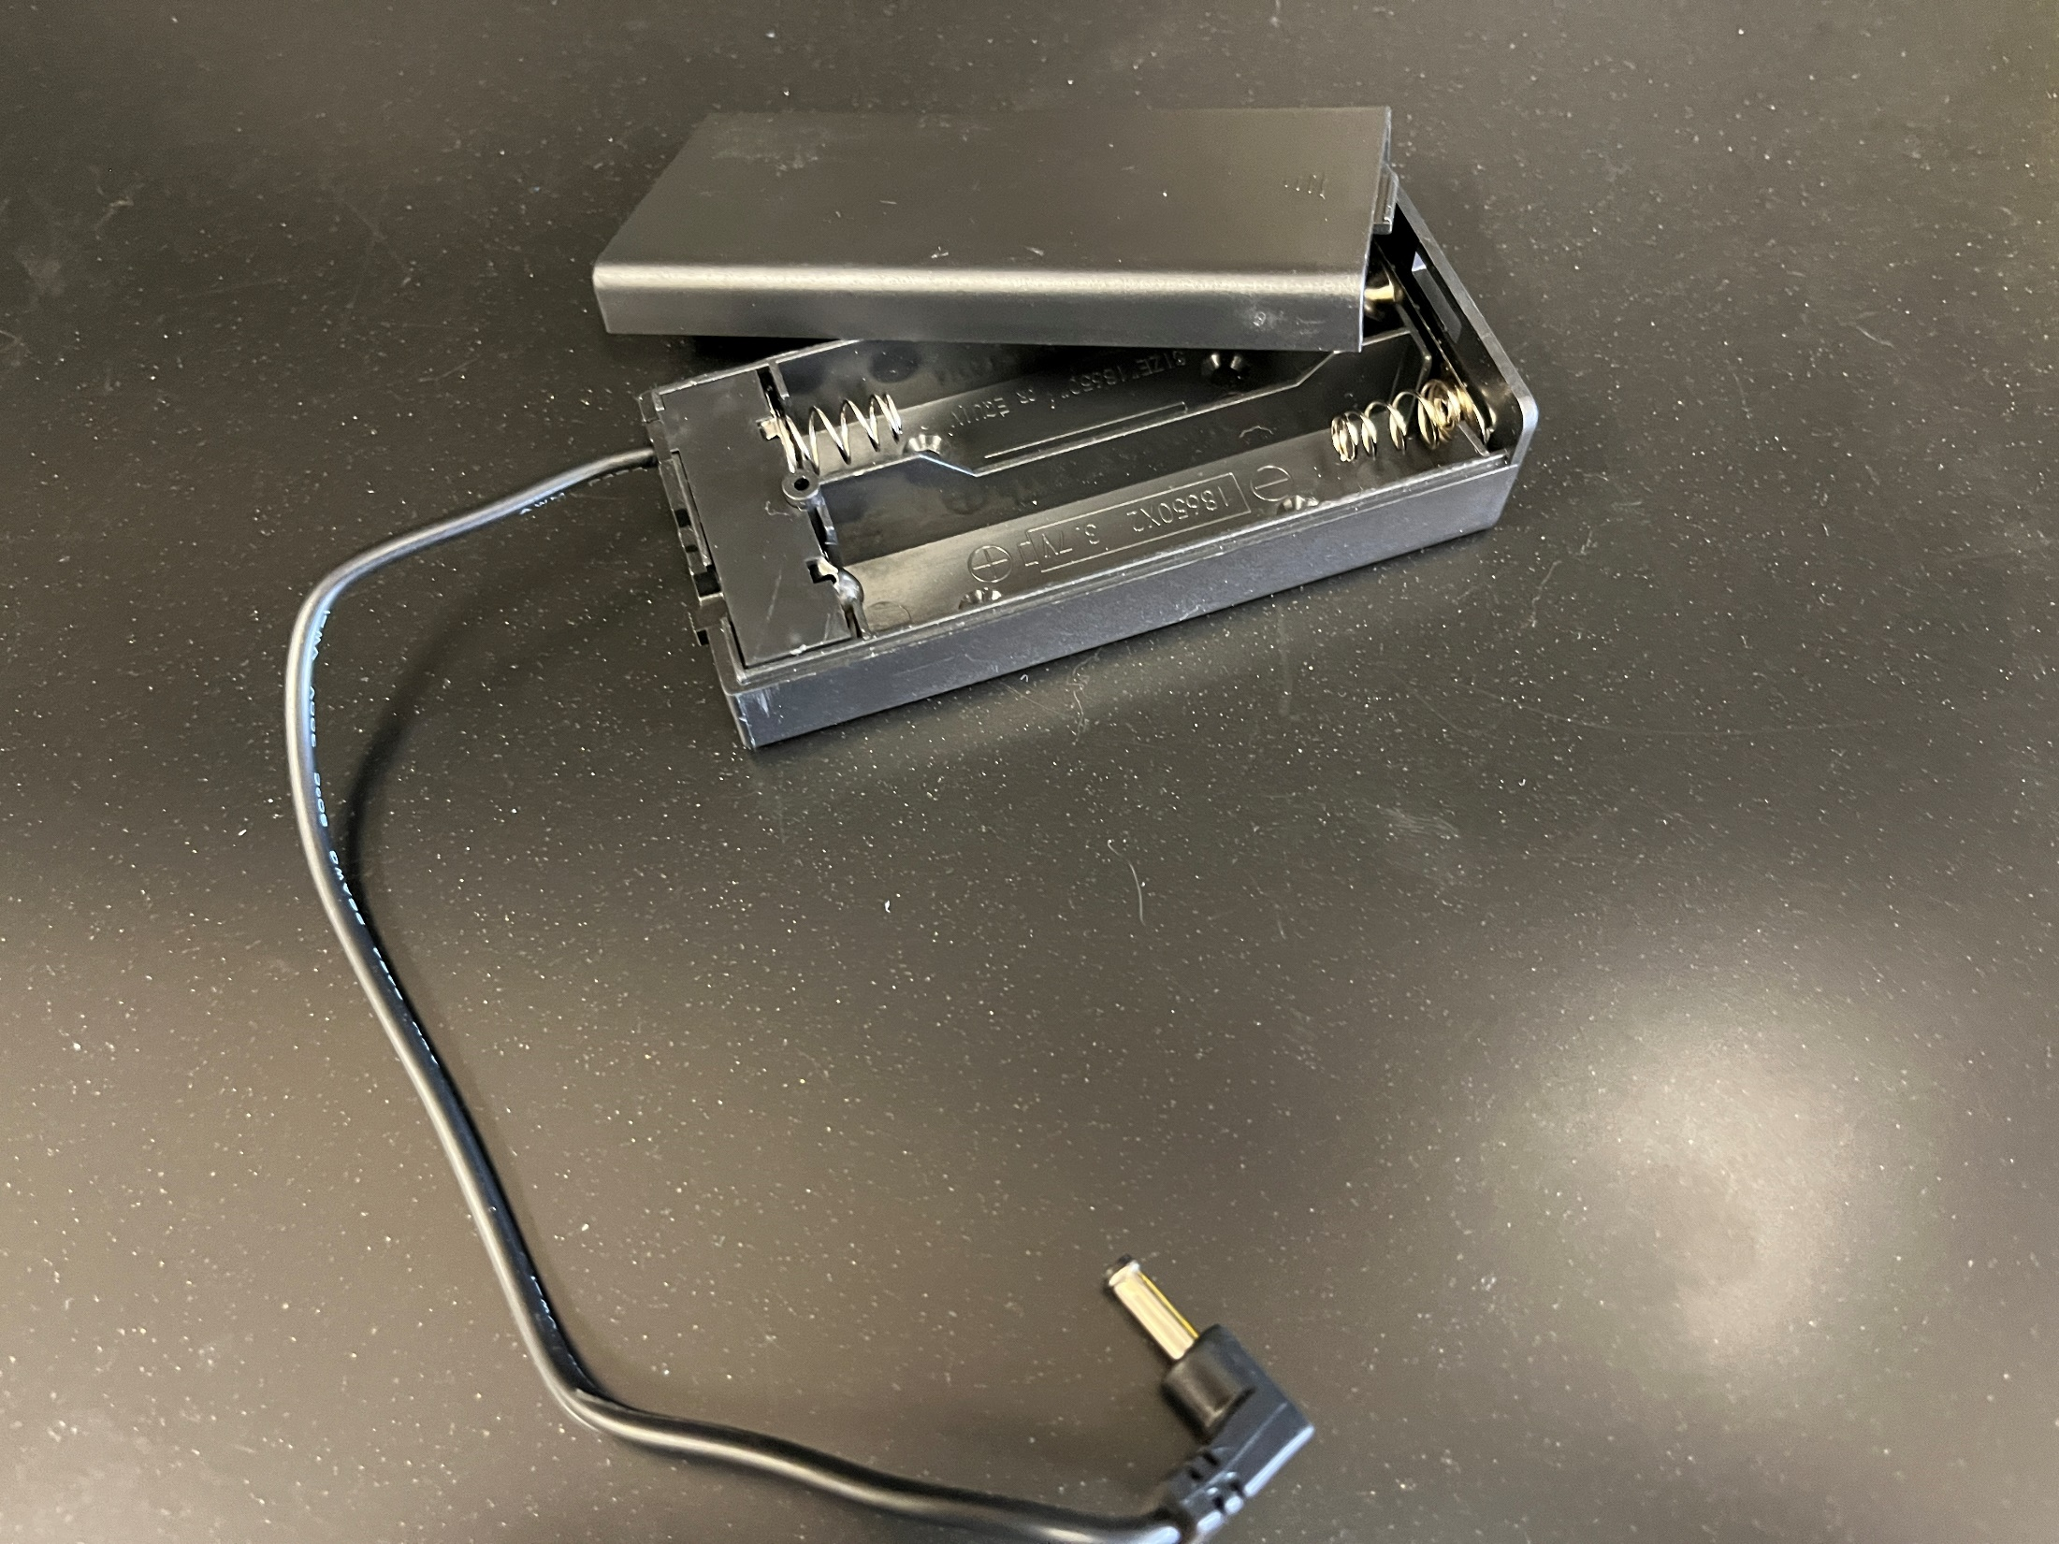
Power
For static demonstrations, the TurboPi will be powered through the USB-C power port on the raspberry pi.​
For dynamic demonstrations, the TurboPi will be powered through the onboard 18650 batteries.​
Do not use the battery pack and the USB-C power at the same time as this may damage the raspberry pi or expansion board.
Batteries must be removed to be charged. The raspberry pi will not charge them

Slide 8
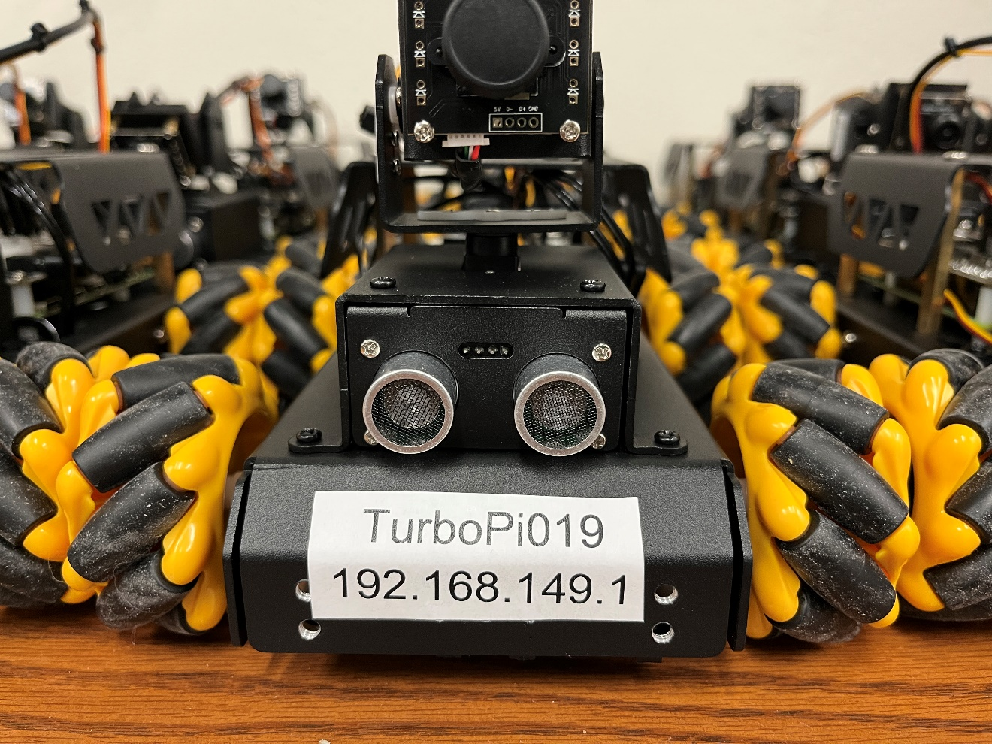
Connecting
When turned on, the TurboPi will beep to notify you it is ready to use​
The TurboPi will automatically launch a wifi hotspot which you can use to connect​
Network SSID​
The hostname has been taped to the TurboPi​
In the image it is “turbopi019“
Network Password​
Enter the hostname of the TurboPi
In the image it is “turbopi019”
Use Windows Remote Desktop to connect to “192.168.149.1” to access the TurboPi

